Slide 1

OSINT
Rymer Popovich

Slide 2

Web Scraping
The process of automatically extracting data from websites and transforming it into structured formats (spreadsheets, tables, databases, etc.)
Involves sending HTTP request to a web page, parsing the HTML structure to locate the information, and storing that data.
This technique is very useful for collecting public online data such as prices or statistics when APIs are unavailable.

Slide 3
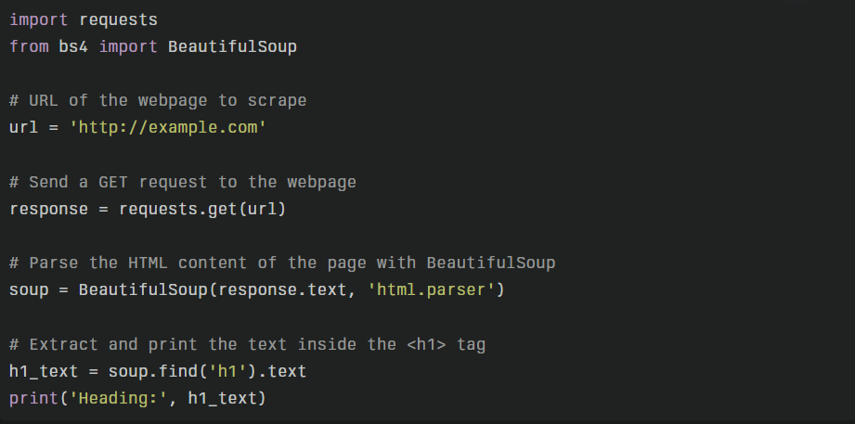
Web Scraping Example

Slide 4

Metadata Analysis
The process of examining descriptive information (metadata) associated with datasets/digital files, to uncover hidden patterns or relationships.
Metadata – includes details about creation date, author, file type, etc.
By analyzing this data, organizations can improve data governance, detect anomalies, and ensure compliance

Slide 5
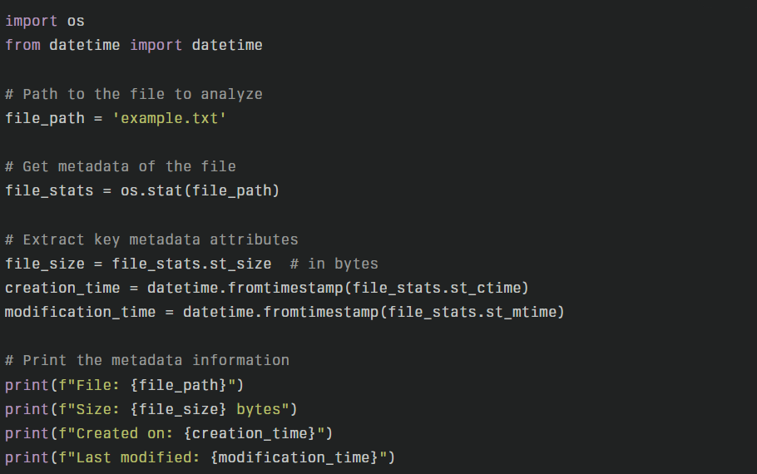
Metadata Analysis Example

Slide 6
References
Metadata Analysis - A complete guide to metadata analysis. (2021, February 16). Canto. https://www.canto.com/blog/metadata-analysis/
OSINT - Nordine, J. (2019). OSINT Framework. Osintframework.com. https://osintframework.com/
Web Scraping - Osborne, J. (2024, April 7). Intro to Web Scraping: Build Your First Scraper in 5 Minutes. Medium. https://medium.com/@joerosborne/intro-to-web-scraping-build-your-first-scraper-in-5-minutes-1c36b5c4b110

